Slide 1
ChatVideo
A VIDEO CHATTING WEB APP BUILT USING REACT.js

Slide 2
INTRODUCTION TO MAIN PROJECT
A website where you can connect with your friends and have one to one video chat with
them. It would be fun and you will get to understand how we can send video streams
through a connection.

Slide 3
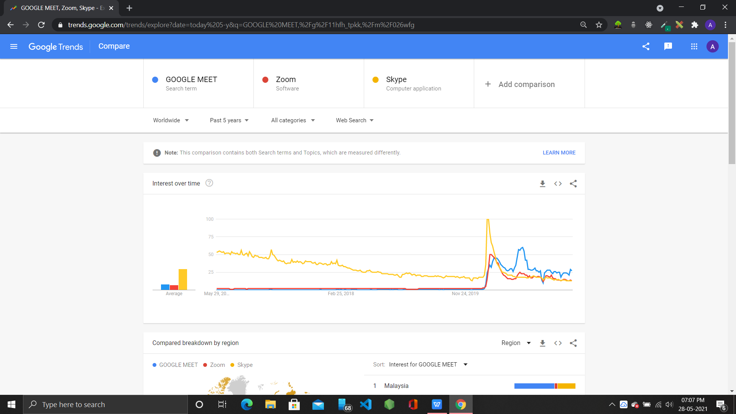
SURGE GRAPH

Slide 4
TOOLS AND TECHNOLOGIES USED
React.js
Node.js
Express.js
simple-peer
socket.io
socket.io-client
Material-ui/core
material ui/icons
VS-Code
cors
React-copyt-to-clipboard

Slide 5
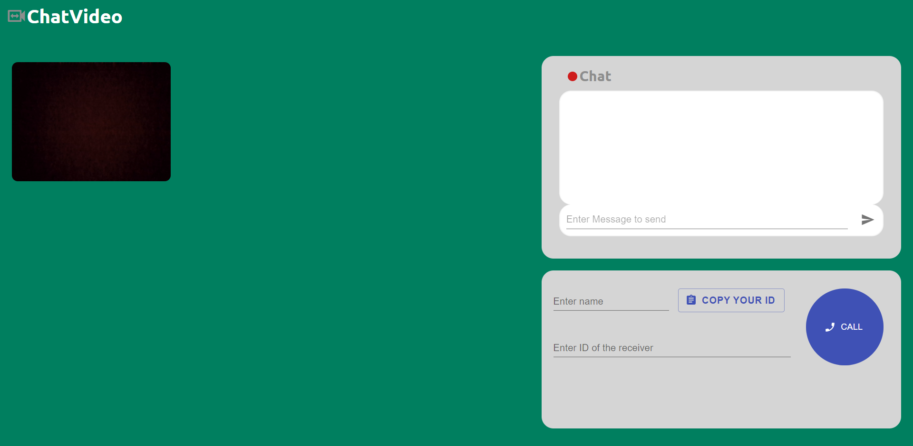
ChatVideo-Webapp
This is the landing page of the website.

Slide 6
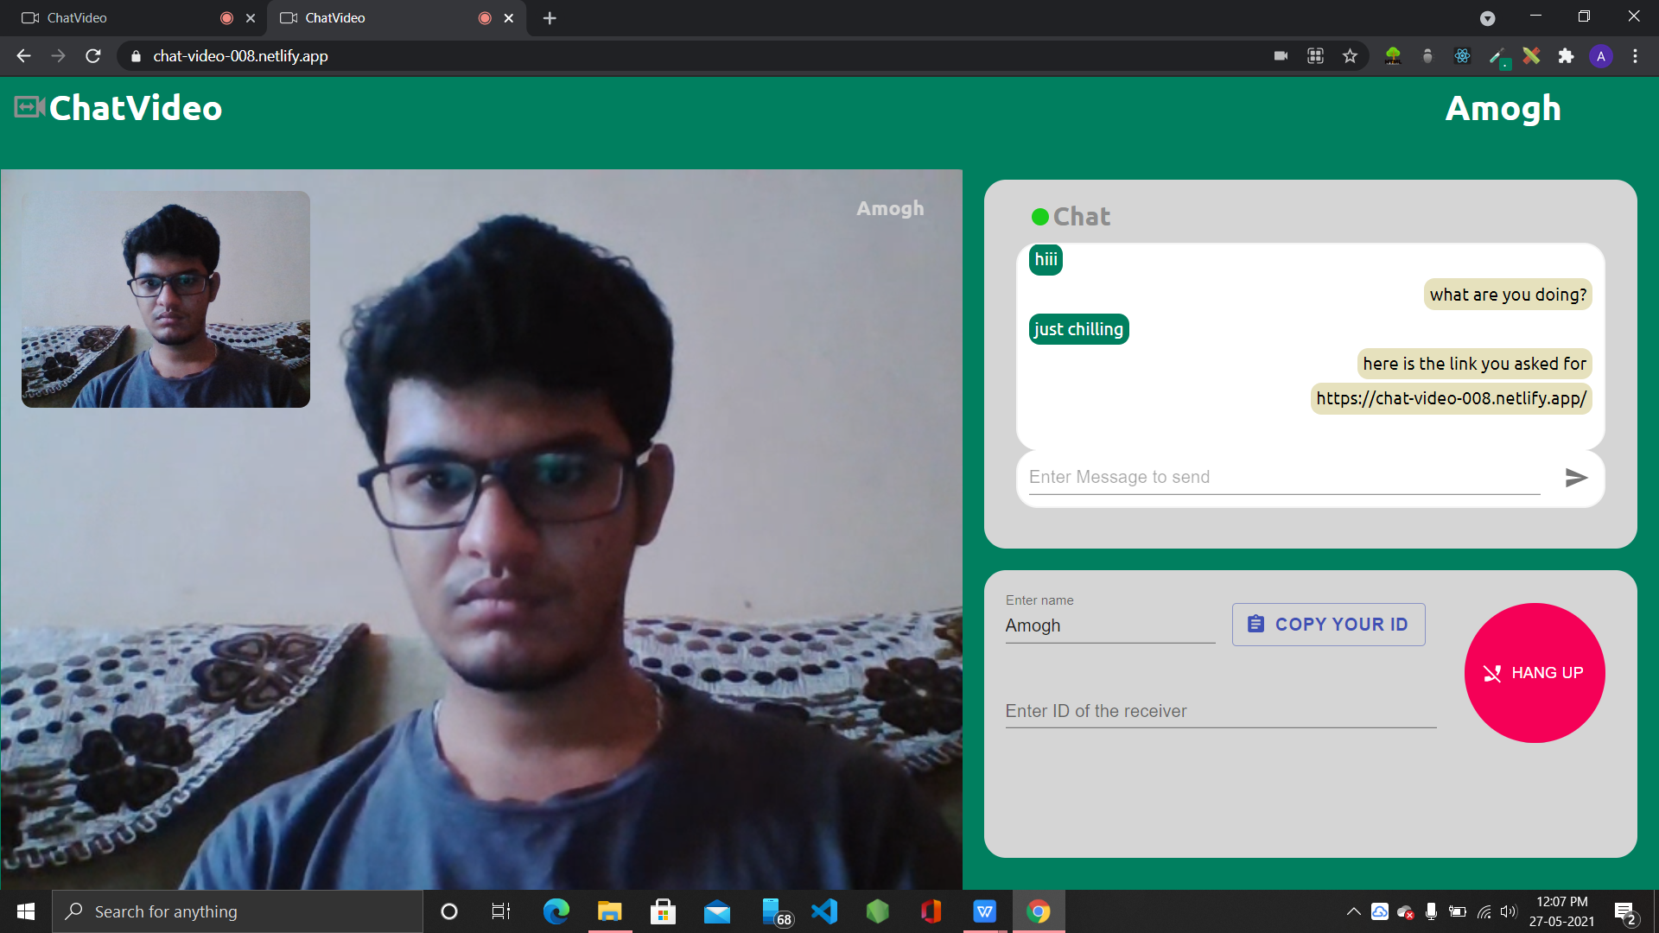
VIDEO CHAT IN ACTION
.

Slide 7
MORE ABOUT THE WEBSITE
The video sharing is acheived by peer to peer connection using simple peer. to estavlish the P2P connection socket.io in combination with express.js on Node.js has been used . To have real time messaging againg socket.io is used

Slide 8
FEATURES
→
OFFLINE
ONLINE
→

Slide 9
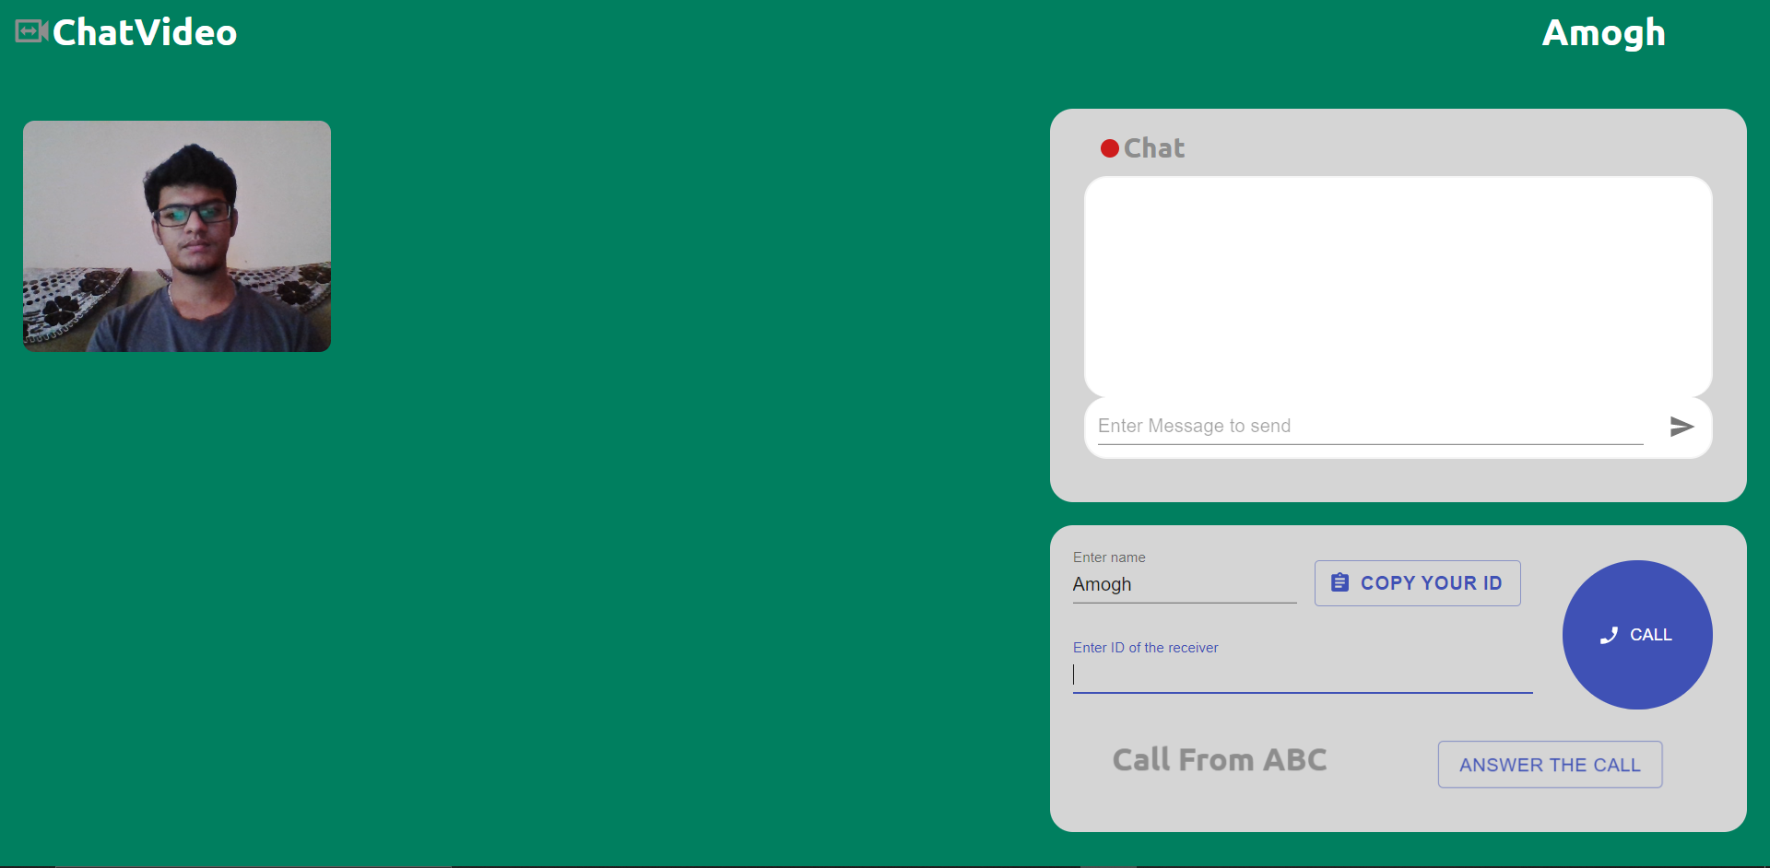
CALL NOTIFICATION AND CALL BUTTON
→
BEFORE CALL
AFTER CALL
→

Slide 10
DYNAMIC NAME CHANGER
DYNAMIC NAME DISPLAY : DISPKYAS THE NAME SIMULTANEOUSLY AS TEH USER ENTERS

Slide 11
RELATED LINKS
link: https://chat-video-008.netlify.app/
GitHub: https://github.com/Amogh008/Project_videoChat

